Slide 1


Slide 2
OVERVIEW

Slide 3
Labor Lab Team Members
Fangxin Zhang Developer
Srividya Pratha Developer
William Djelhi Yahot Product Owner
Abeer Khokhar Developer
Michelle Martinez Scrum Master

Slide 4

Allwyn Corporation
Founded: 2003
Located: Washington D.C.
Goal: Bring industry and academia together
Mission: Provide software solutions in data analysis

Slide 5
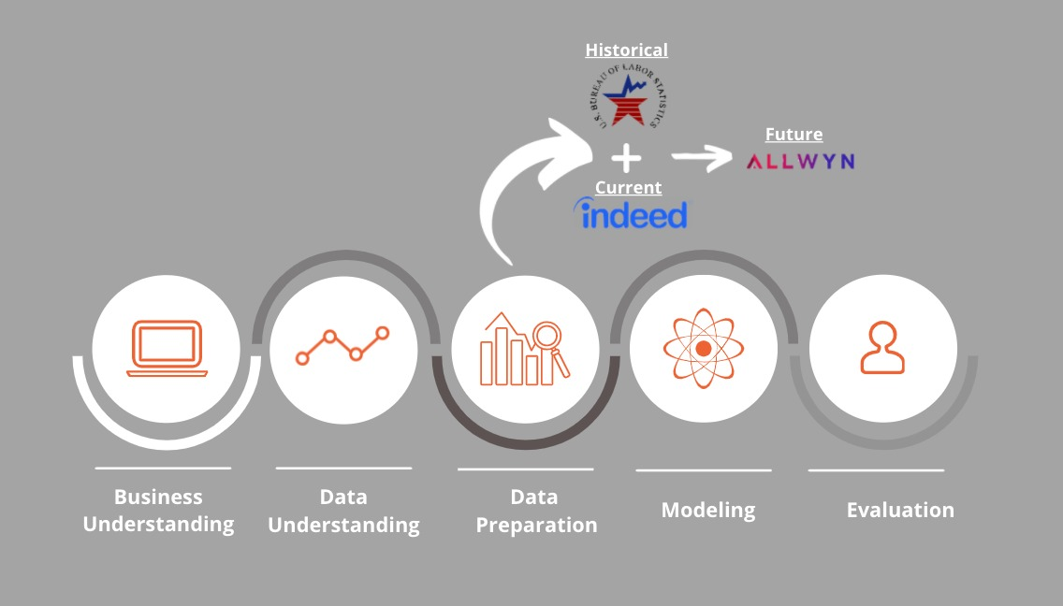
Problem Overview

Slide 6
DATA

Slide 7

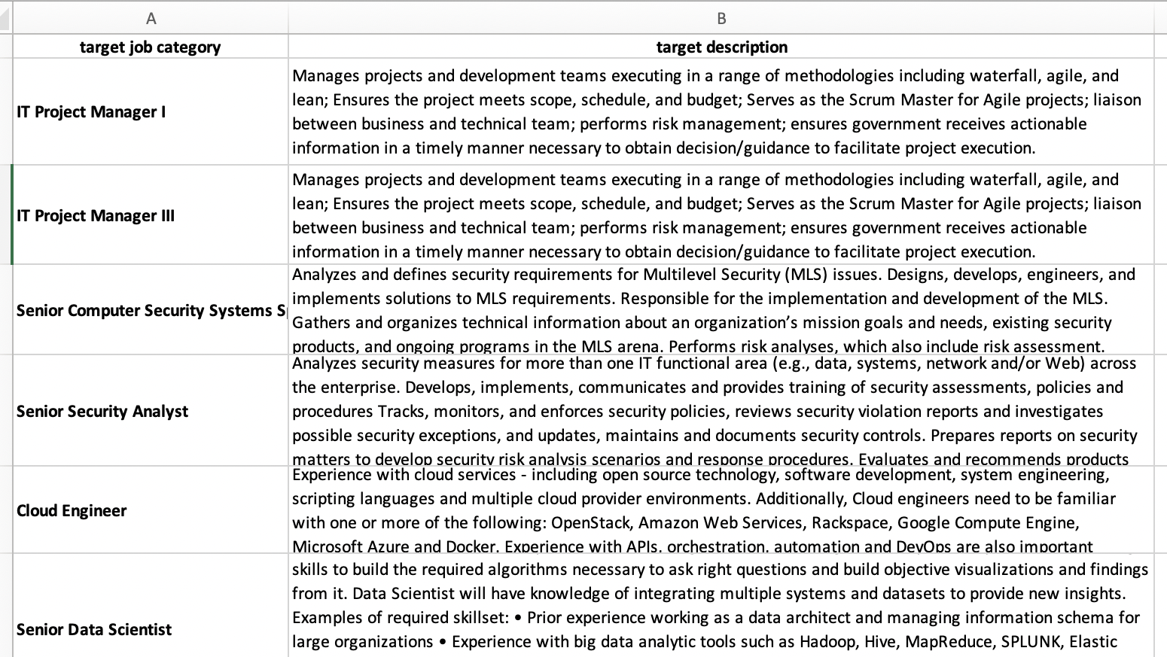
Data - Allwyn Corporation
Data Inputs: Allwyn.xlsx
SIN by Labor Category
Job Description
SIN | Labor Category
54151S | IT Project Manager I
54151S | IT Project Manager III
54151S | Senior Computer Security Systems Specialist
54151S | Senior Security Analyst
54151S | Cloud Engineer
54151S | Senior Data Scientist
54151S | User Experience (UX) Developer
54151HEAL | Health IT Software Developer I
54151HEAL | Health IT Software Developer III
54151S | Test Automation Engineer

Slide 8

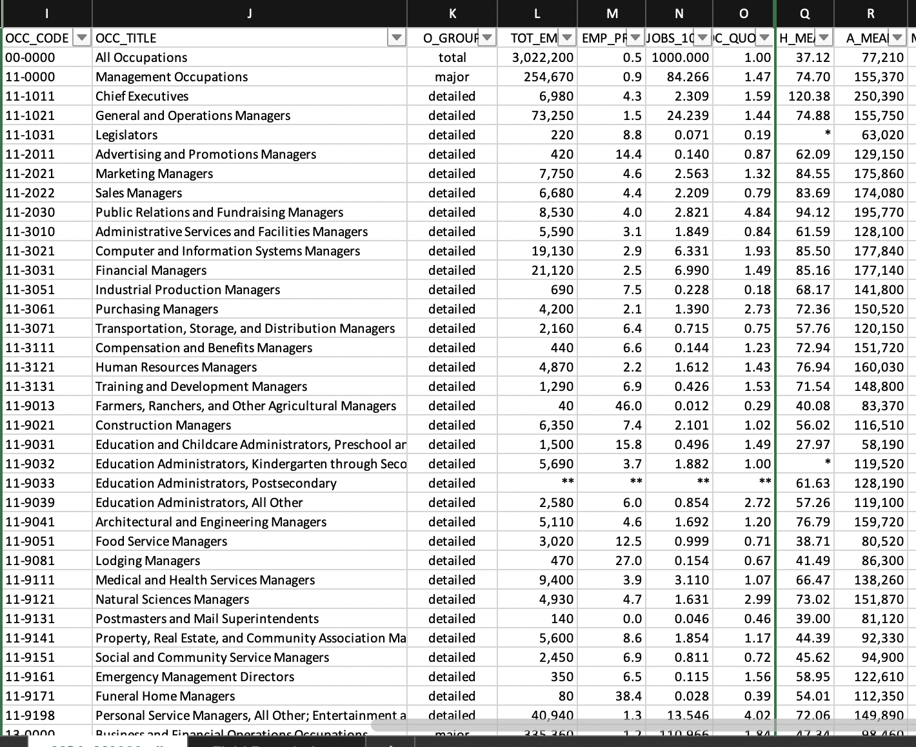
Data – Occupational Employment and Wage Statistics
Dataset Name:
U.S. Bureau of Labor Statistics
Dataset Size:
Multiple Datasets,
Analytic/Algorithm that will use dataset
Dataset Time Range:
ten years (2011-2020)
TPOT regression
Exponential Smoothing
Dataset Owner:
Occupational Employment and Wage Statistics
total approximately 1.75 GB

Slide 9

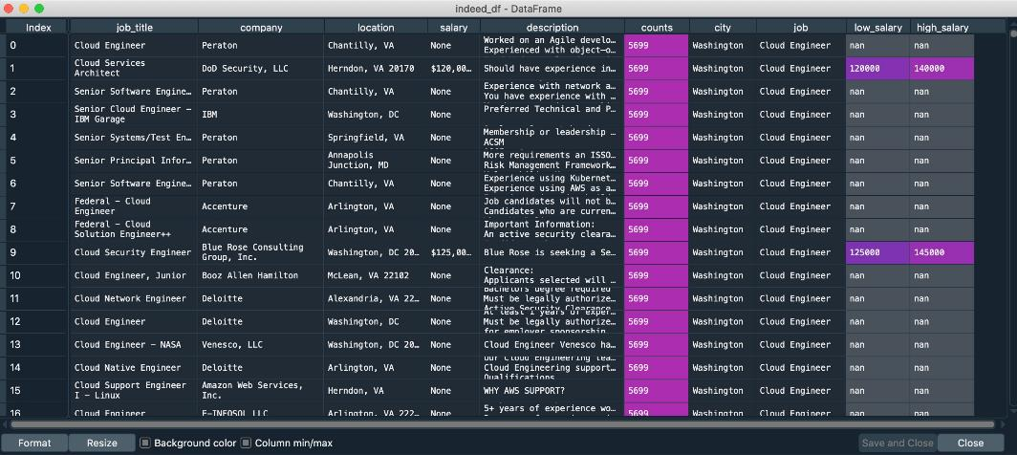
Data – Indeed

Slide 10
ANALYTICS

Slide 11
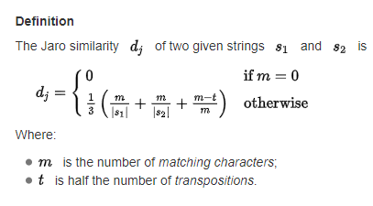
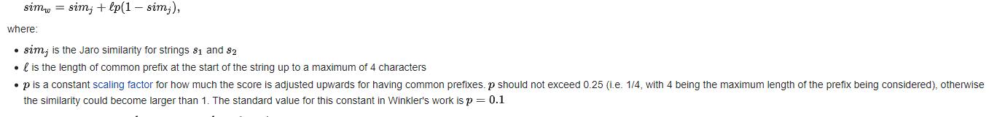
Edit Distance Measure
I. Jaro Similarity
Measure of two strings' similarity:
the higher the value, the more similar the strings are.
The score is normalized such that 0 equates to no similarities and 1is an exact match.
II. Jaro–Winkler Similarity
It uses a prefix scale p which gives more favorable ratings to strings that match from the beginning for a set prefix length

Slide 12
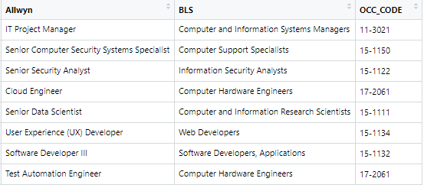
Edit Distance Measure
I. Q Gram Distance
Q Gram Distance is a metric that returns the best matches.
This is the metric for which necessitated the least amount of on tops.

Slide 13
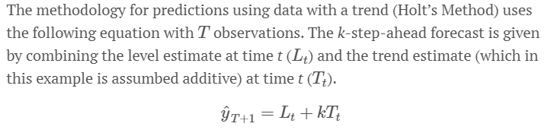
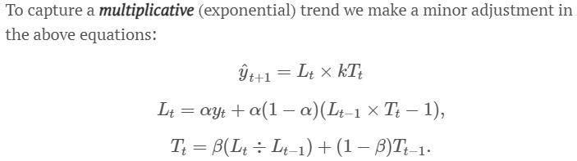
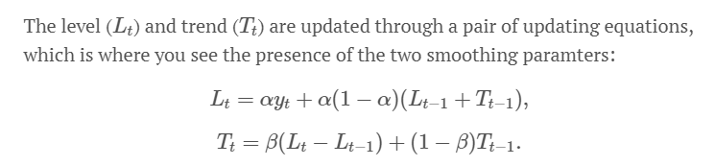
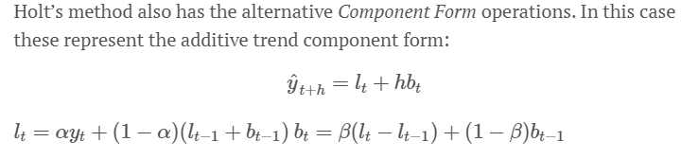
Exponential Smoothing
I. Holt’s Exponential Smoothing
Time series forecasting method.

Slide 14
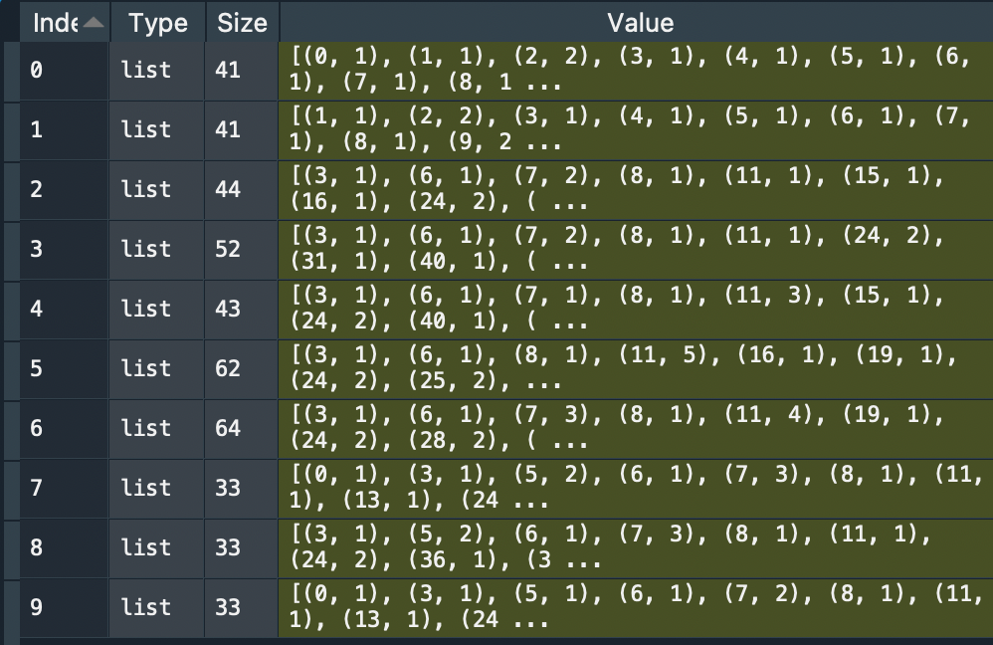
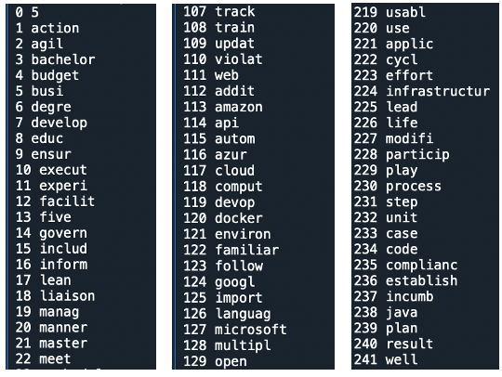
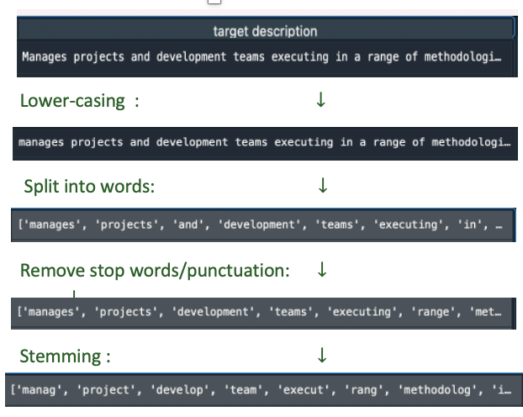
Natural Processing Language (NLP)
Modeling name: Latent Semantic Analysis (LSI)
Step 1: Preprocessing
Step 2: Tokenization
Step 3: Build corpus

Slide 15
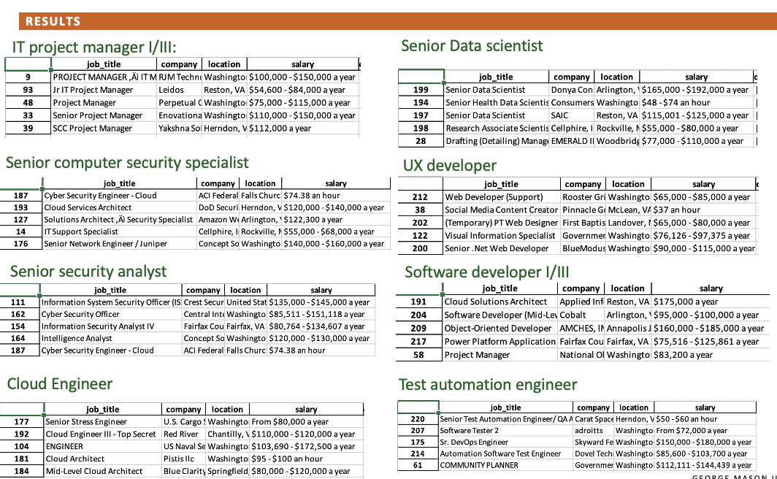
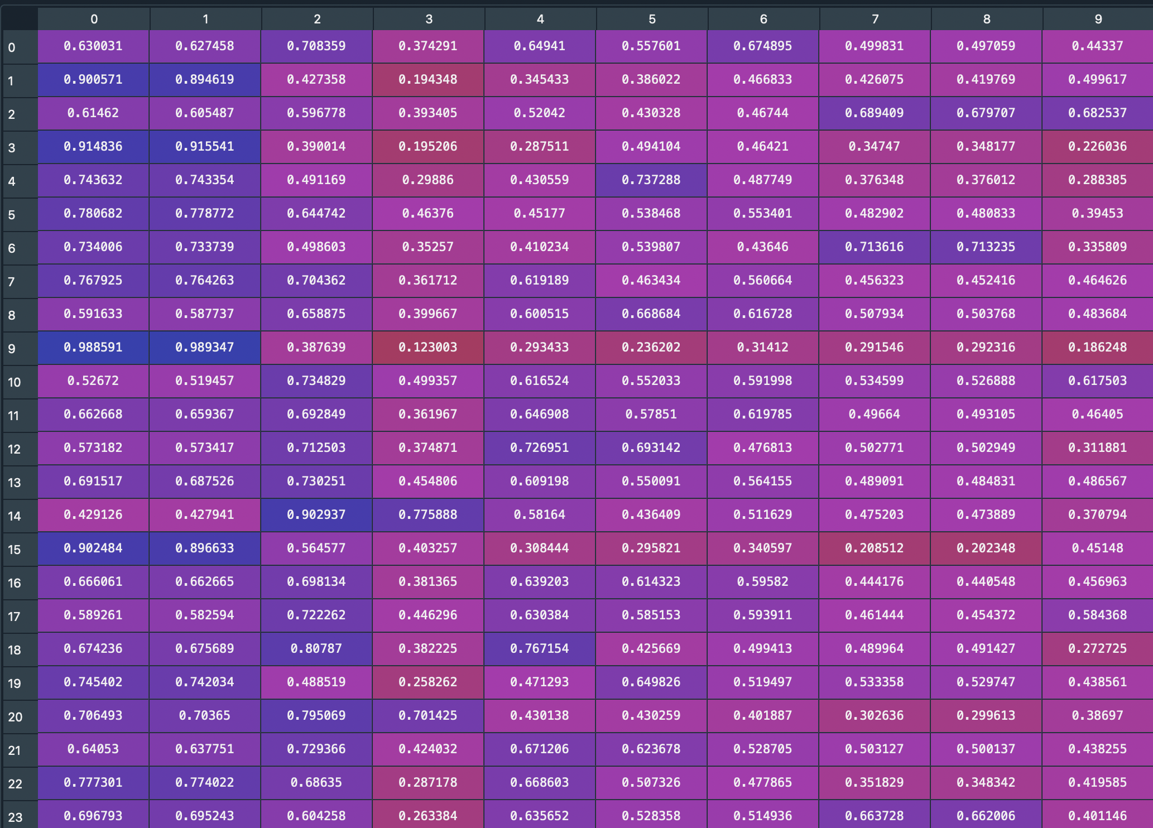
Natural Processing Language (NLP)
Result from Latent Semantic Analysis (LSI)

Slide 16

TPOT Regression
Tests thousands of possible pipelines
Tunes all parameters for you
Produces a best-fit pipeline with the lowest error scores

Slide 17
VISUALIZATION

Slide 18
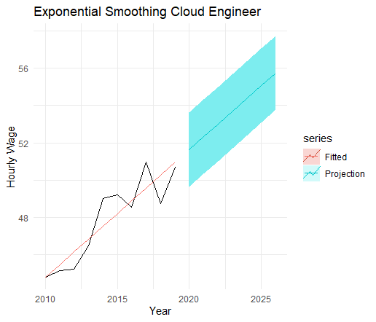
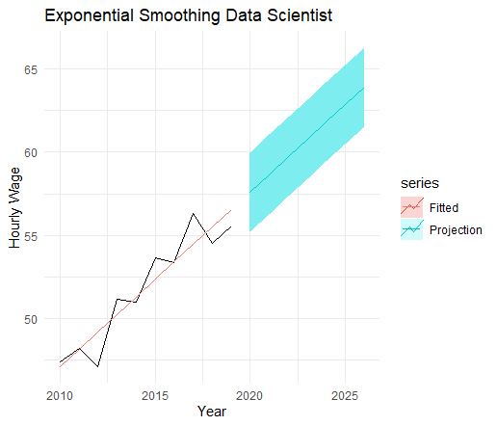
Exponential Smoothing

Slide 19
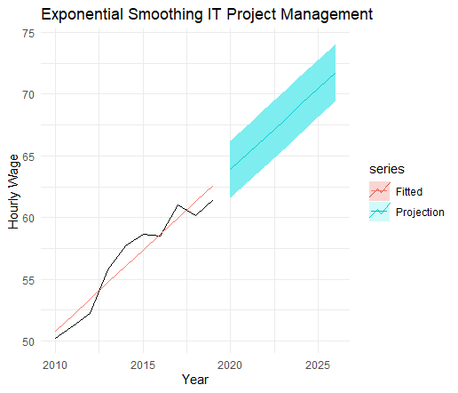

Exponential Smoothing

Slide 20
Exponential Smoothing

Slide 21
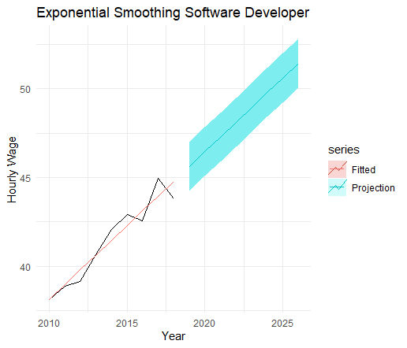
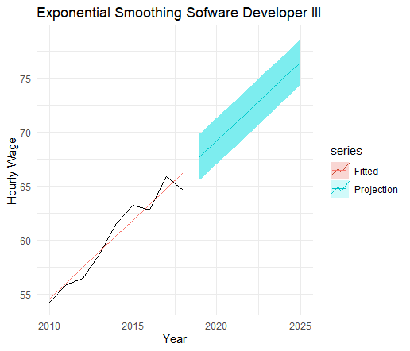
Exponential Smoothing

Slide 22
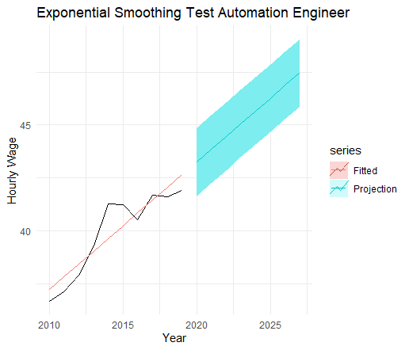
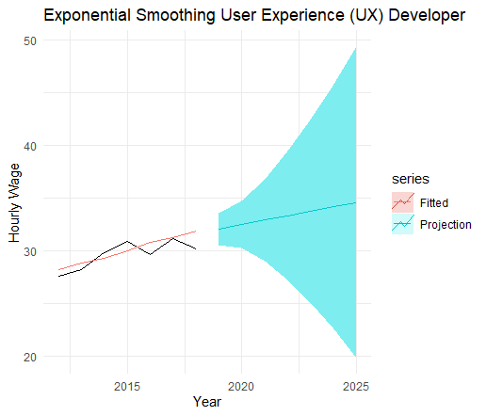
Exponential Smoothing

Slide 23
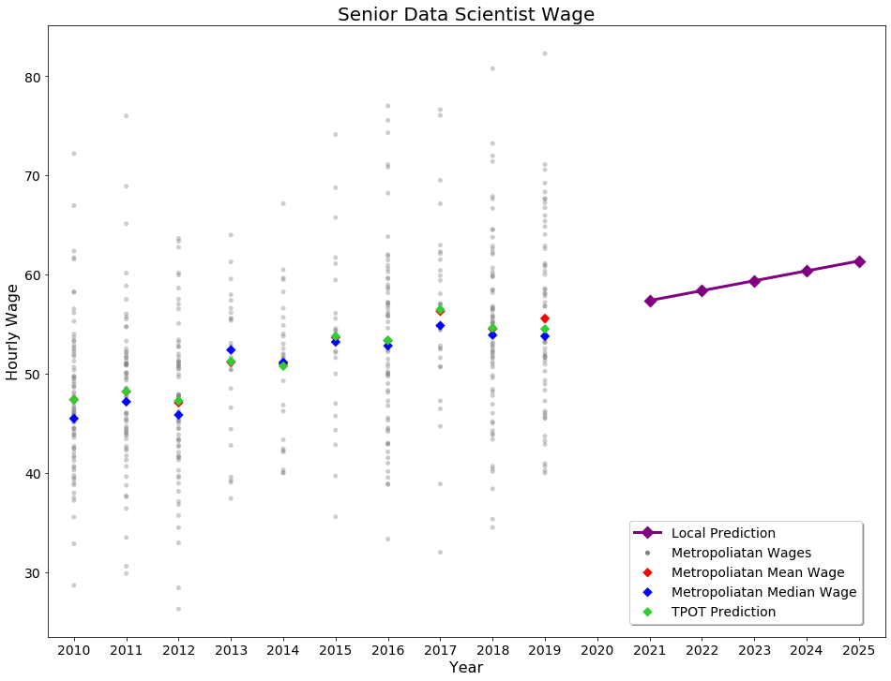
TPOT Regressor

Slide 24
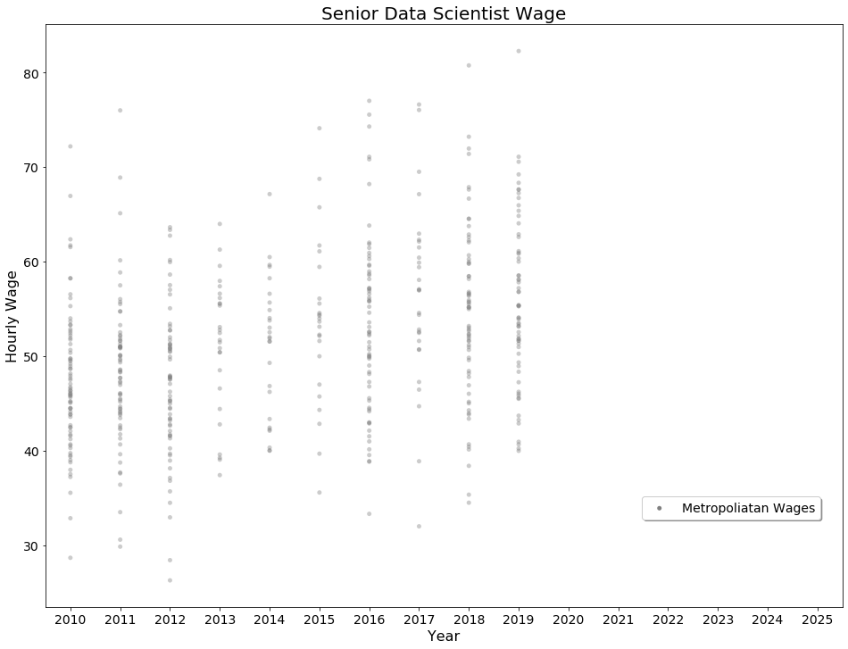
TPOT Regressor

Slide 25
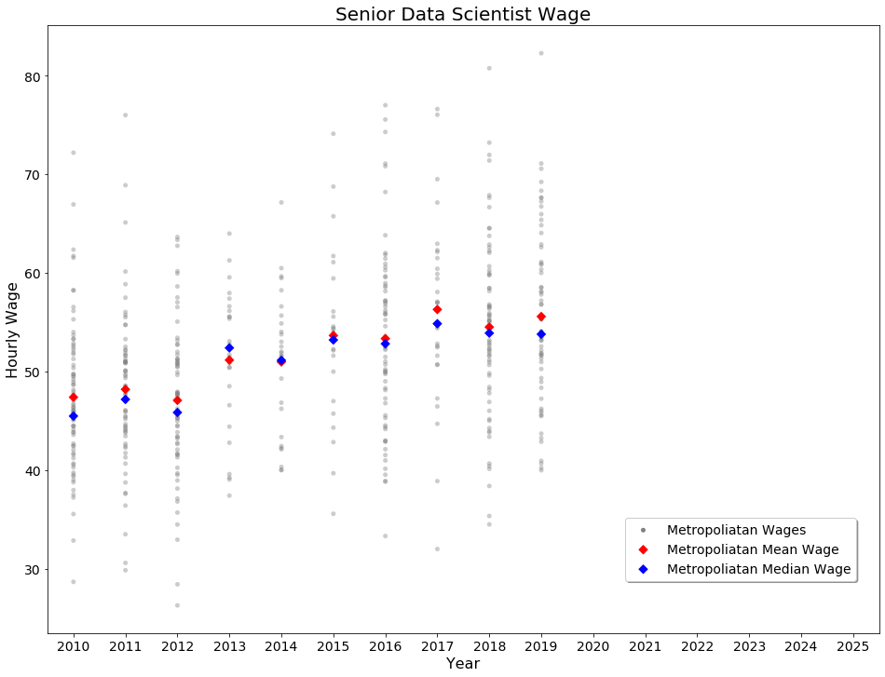
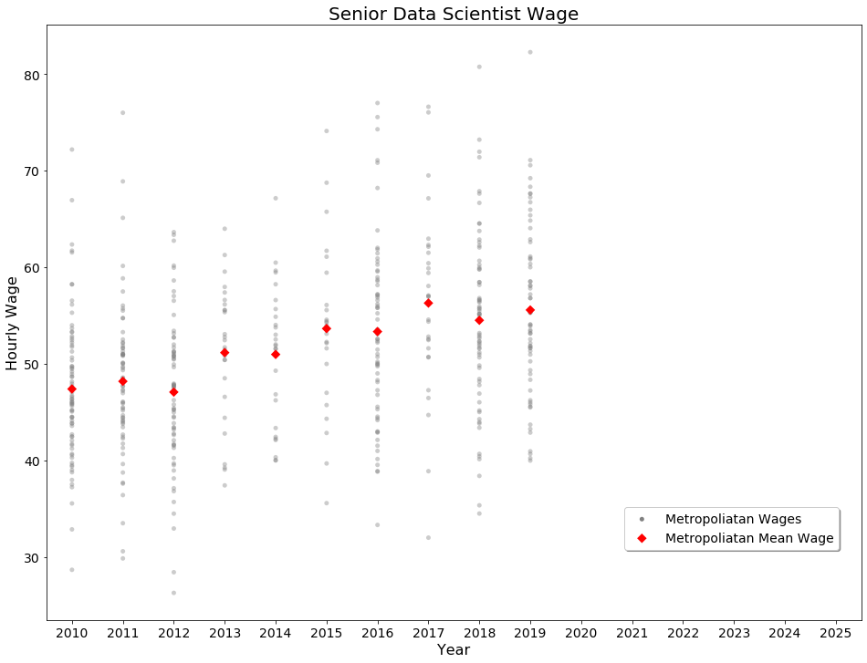
TPOT Regressor

Slide 26
TPOT Regressor

Slide 27
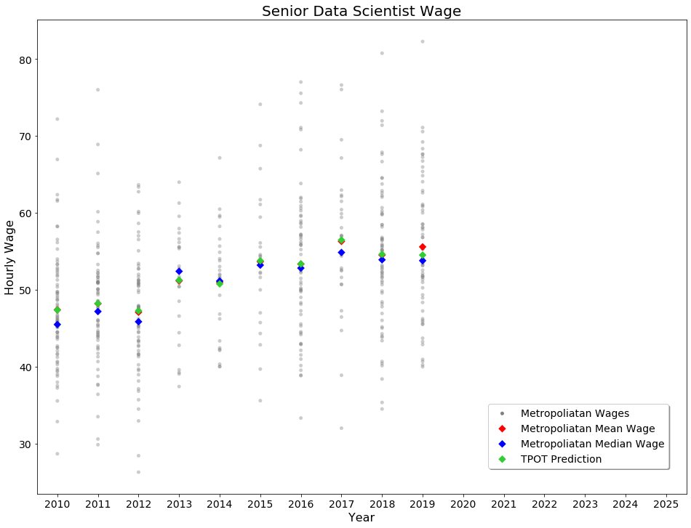
TPOT Regressor

Slide 28
TPOT Regressor

Slide 29
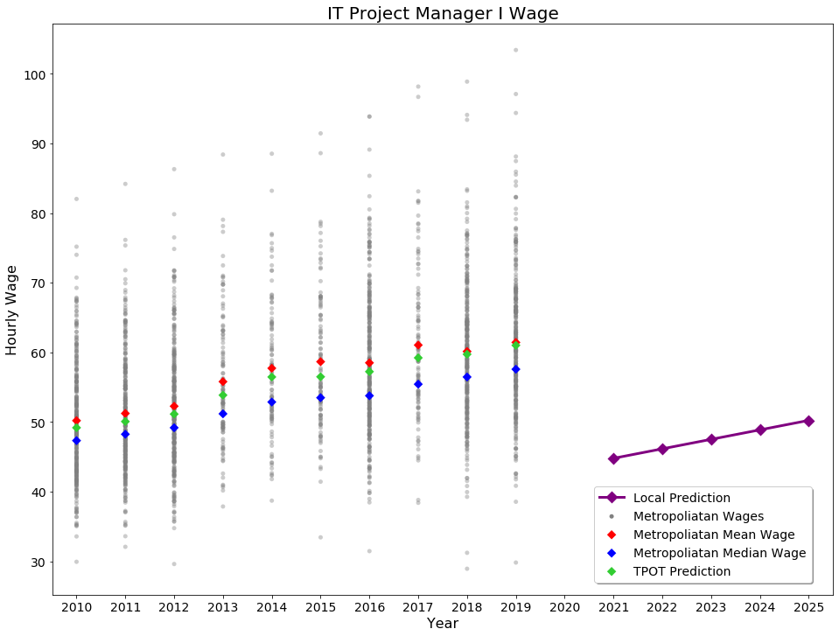
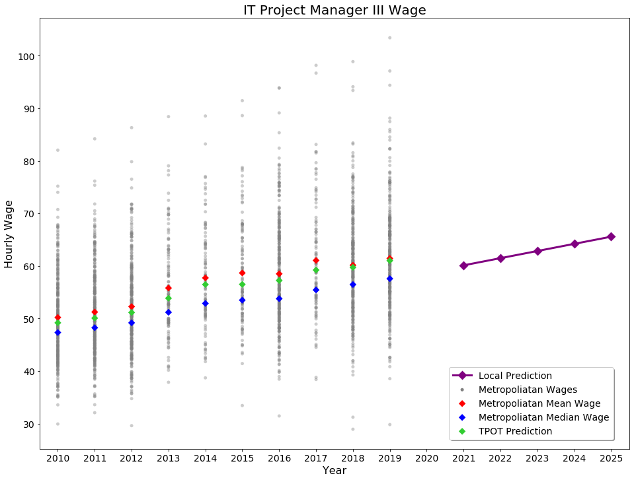
TPOT Regressor

Slide 30
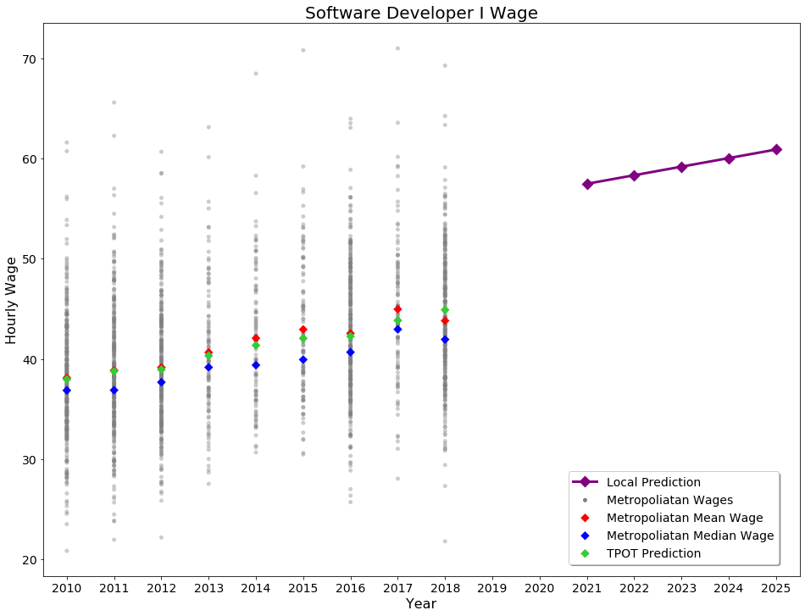
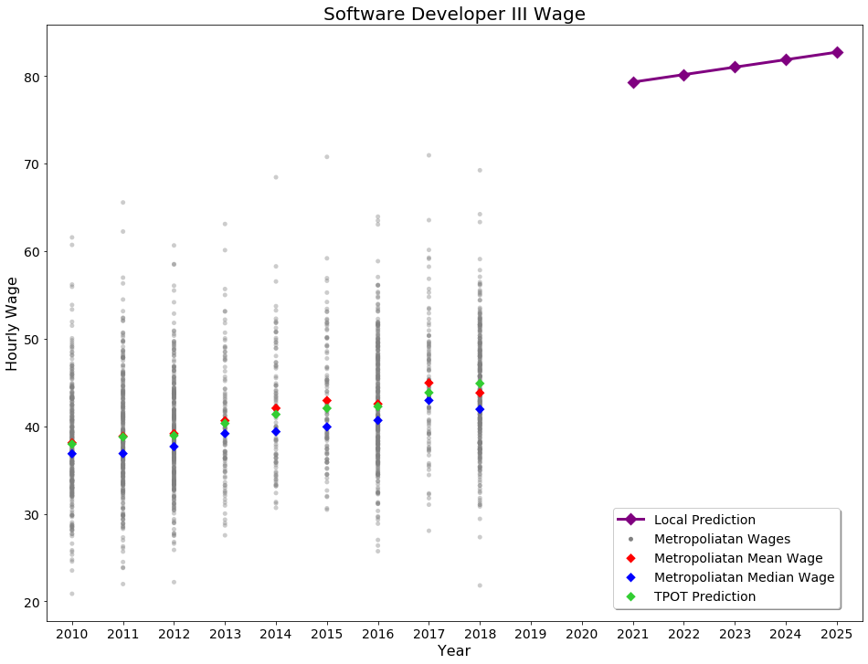
TPOT Regressor

Slide 31
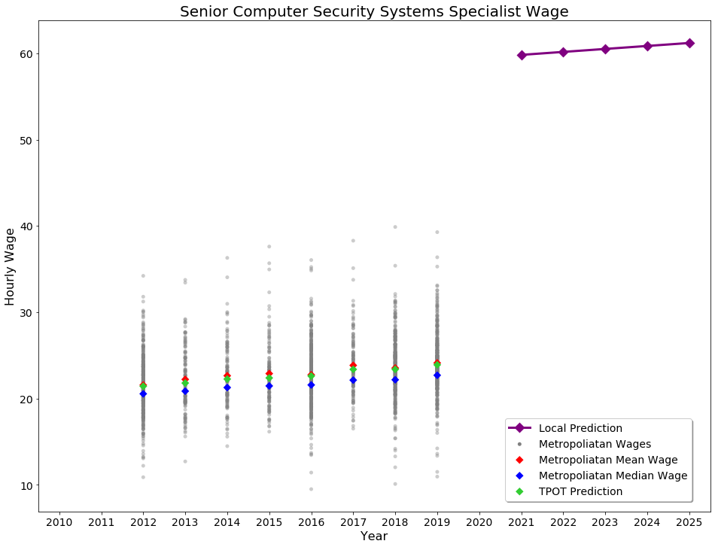
TPOT Regressor

Slide 32
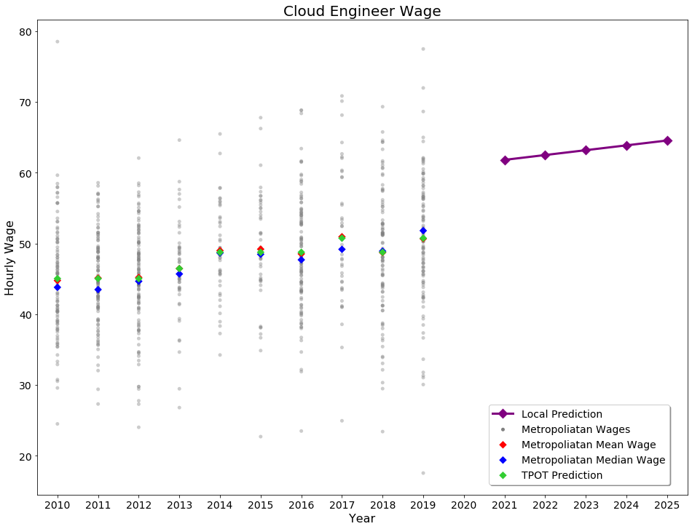
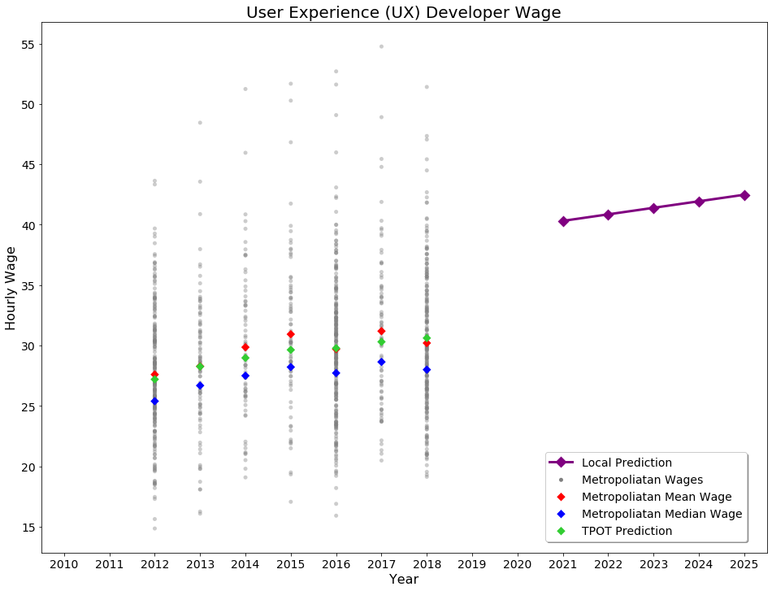
TPOT Regressor

Slide 33
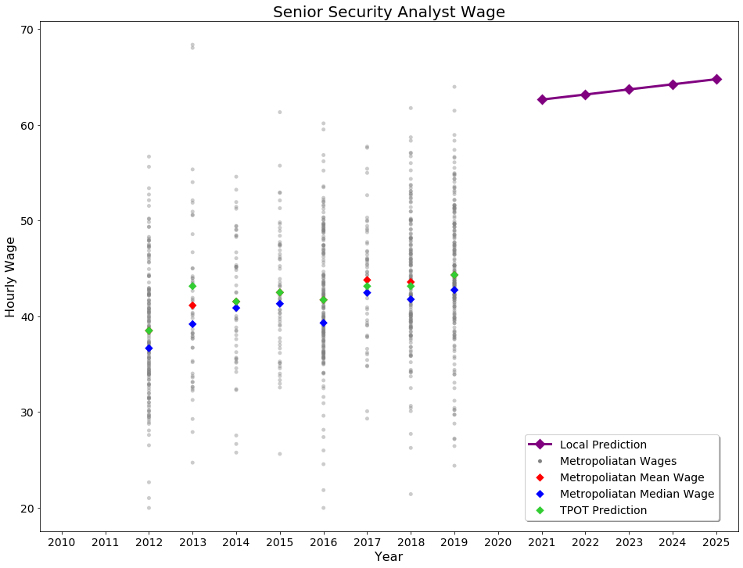
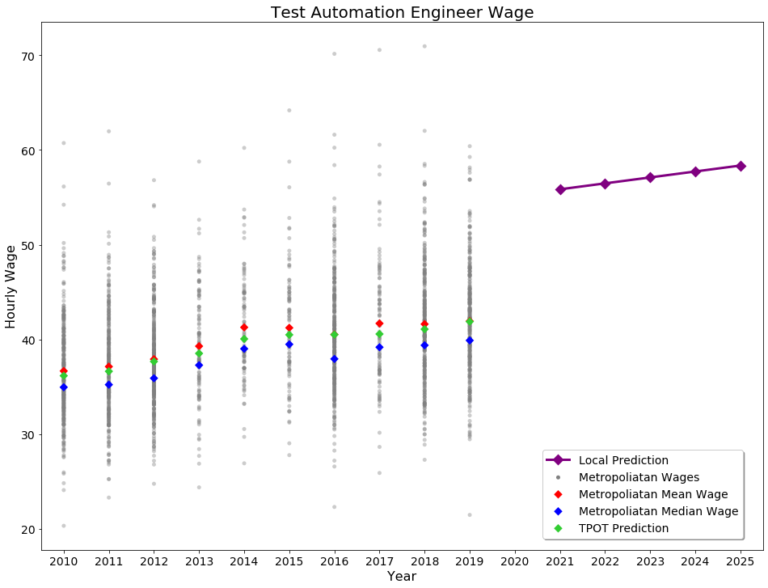
TPOT Regressor

Slide 34
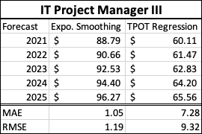
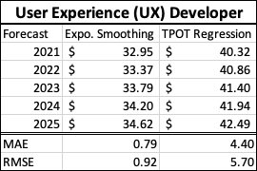
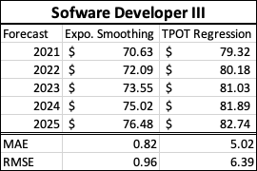
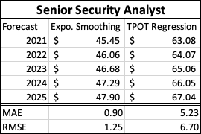
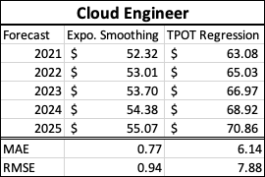
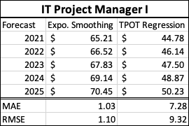
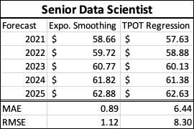
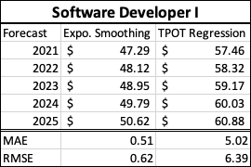
Model Comparison
Exponential Smoothing
TPOT Regressions
Great Accuracy Rate
Does not factor in the local DC Job markets or the description matching
Less robust and comprehensive
Factors in the indeed job description matching

Slide 35
CONCLUSION

Slide 36

Summary
Our Work Helped Allwyn make data-driven decisions
Mapped out a tentative plan for solution
Noted Risks & Planned Mitigation Strategies
Used Freely Available Data for Solution
Our solution works for any labor category/location

Slide 37

Limitations & Future Work
Limitation
Lack of Time
Data
Lack of historical data
Future Work:
Factor in other expected expenses for a more comprehensive cost prediction.
Running the extraction for Indeed every week/month to include data in time periods
Work on sourcing the funds to purchase a comprehensive dataset on labor market rates in IT Labor Market Category.

Slide 38
QUESTIONS?

